Slide 1

Political Bias Detection in News Articles
Carla du Plessis, Nandan Parikh, Bhumika Chopra, Chaithanya Shyam Delanthabettu, Sonika Vuyyuru
Group 29

Slide 2

Introduction
News articles often reflect subtle political bias through word choice, framing, selection, and source attribution
Detecting such bias is critical for improving transparency and helping readers contextualize coverage
This project focused on developing supervised & unsupervised models to predict political bias in news text.
The core hypothesis was that contextual embeddings and end-to-end fine-tuning would substantially improve predictive performance over simpler models that rely on shallow representations.

Slide 3
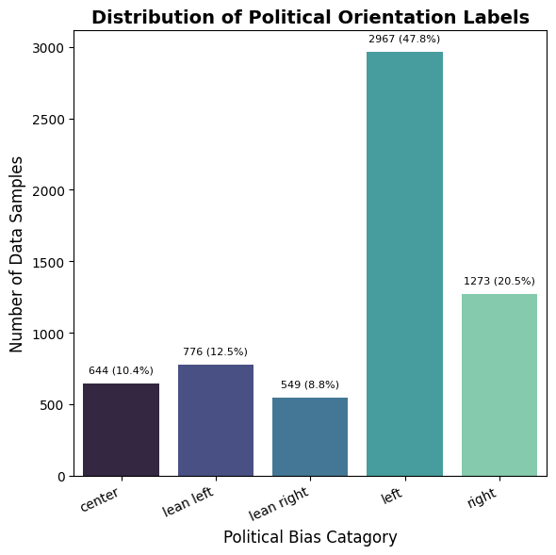
Explaining our Dataset (AllSides)
Dataset Exploration
Initial Volume: Raw dataset contained 8,112 rows and 5 columns (`Title`, `Link`, `Text`, `Source`, `Bias`)
Text: Full body/content of the article.
Bias: The target label indicating the political leaning of the article. Pre-processing
Text Cleaning: Identify & correct decoding/encoding (for eg, HTML tags) issues when parsing articles into strings.
Garbage Removal: Filtered out rows with text length < 50 (e.g., empty or error messages), removing 1,903 rows.
Final Volume: Retained 6,209 high-quality rows (approx. 76.5% of the original data).
Class Imbalance
Bias Skew: The dataset is heavily skewed, with "left" being the most frequent bias label (2,967/ 47.8% instances in the cleaned data).
Source Skew: Every publishing house in this dataset only has articles of one label.

Slide 4
Unsupervised Learning Results & Analysis

Slide 5
Technical Overview: Unsupervised
Feature Engineering
MiniLM sentence embeddings (384-dim, PCA → 50) for semantic structure
Why Clustering?
Evaluated different clustering algorithms to detect more complex structural aspects
Evaluation Metrics
Silhouette score (measure of similarity in vs. out of cluster)
2D PCA visual separation to judge cluster qualities

Slide 6
Methods: Unsupervised
We implemented several unsupervised clustering techniques:
K-Means & Mini-Batch K-Means
Gaussian Mixture Model (GMM) and Bayesian Gaussian Mixture Model
Density-based methods: DBSCAN, HDBSCAN, OPTICS, & Mean Shift
Hierarchical Clustering: Agglomerative Clustering & Birch
Spectral Clustering
Trained our model by grouping data from specific news sources into 5 categories to predict left or right-leaning articles:

Slide 7
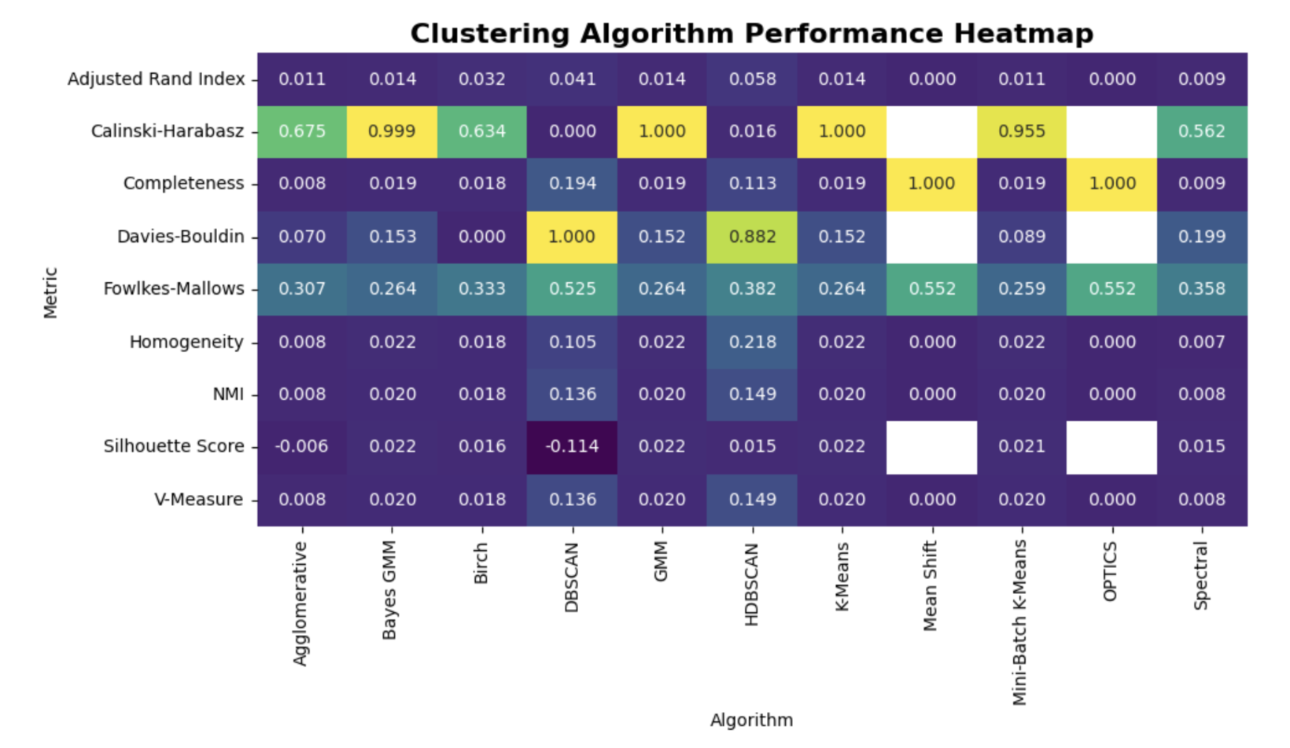
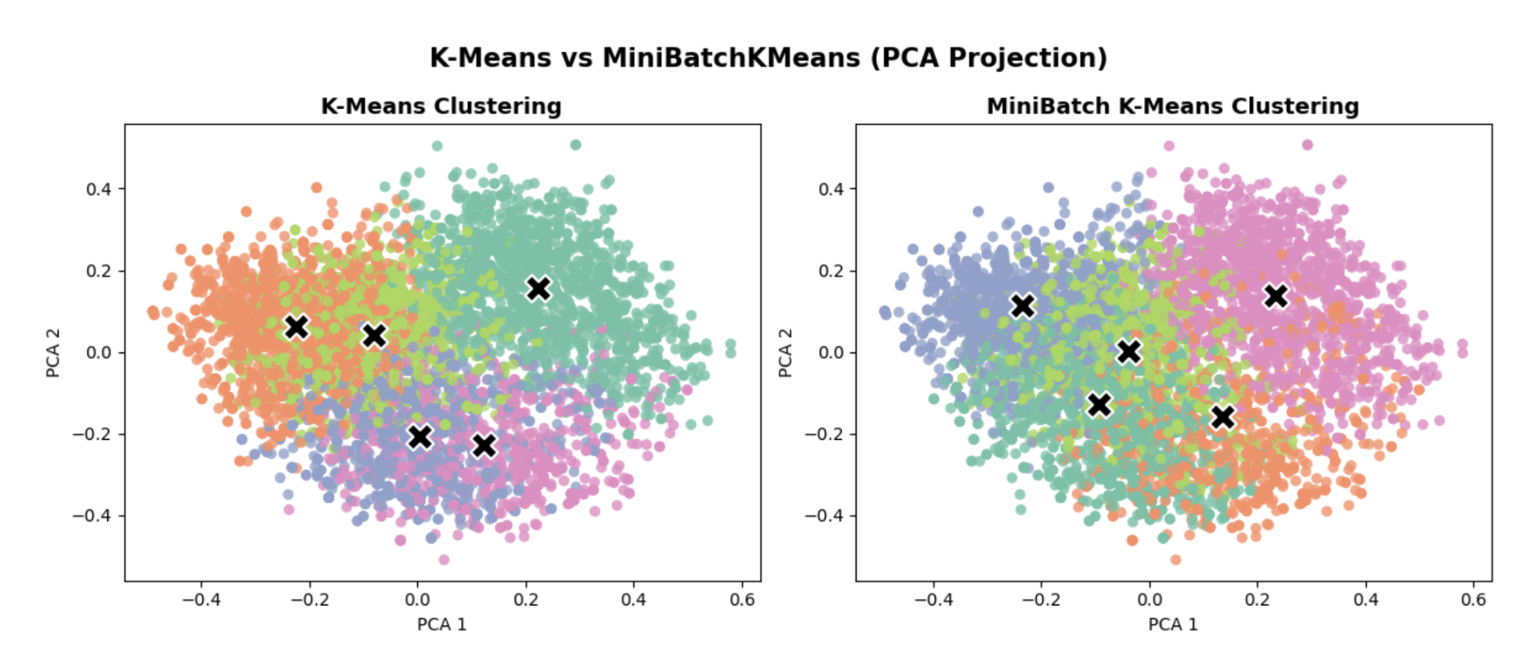
Results: Unsupervised
DBSCAN, HDBSCAN, and Mean Shift had the highest performances across the quality metrics
Heat Map showed that Calinski-Harabasz, Completeness, Davies-Bouldin, & Fowlkes-Mallows performed well on handling cluster density
However, political bias data showed to have overlapping clusters
Underlying relationships are subtle or difficult to capture using clustering methods
Dimensionality Reduction Insights
PCA 2D visualizations showed significant overlap showing that political orientation does not separate cleanly without supervised signals.
Demonstrates meaningful comparisons between different approaches & models

Slide 8
Supervised Learning Results & Analysis

Slide 9
Technical Overview
Methods
Naïve Bayes
Fine-tuning RoBERTa
MLP + TF-IDF
Why?
RoBERTa captures subtle framing & semantics
TF-IDF captures explicit lexical signals
Evaluation Metrics
Accuracy, precision, recall
F1 score (weighted and macro): Harmonic mean of precision and recall
Macro F1 to handle class imbalance across bias labels

Slide 10
Methods: Supervised
Models we used:
Method 1: Gaussian Naïve Bayes + SentenceBERT embeddings
Method 2: Fine-tuned RoBERTa
Method 3: MLP + TF-IDF embeddings

Slide 11
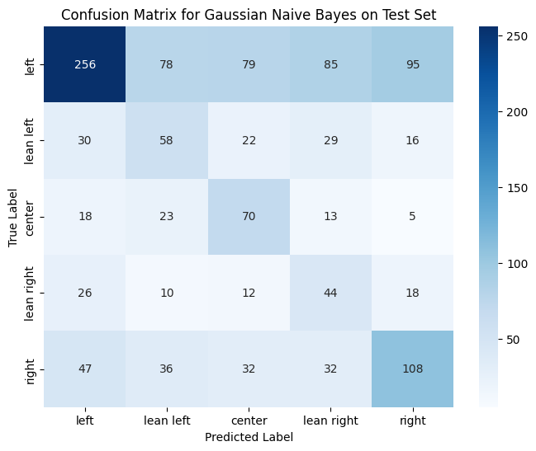
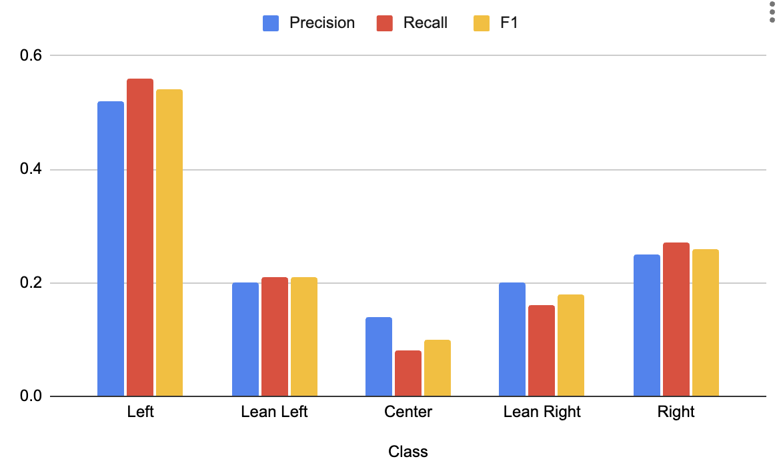
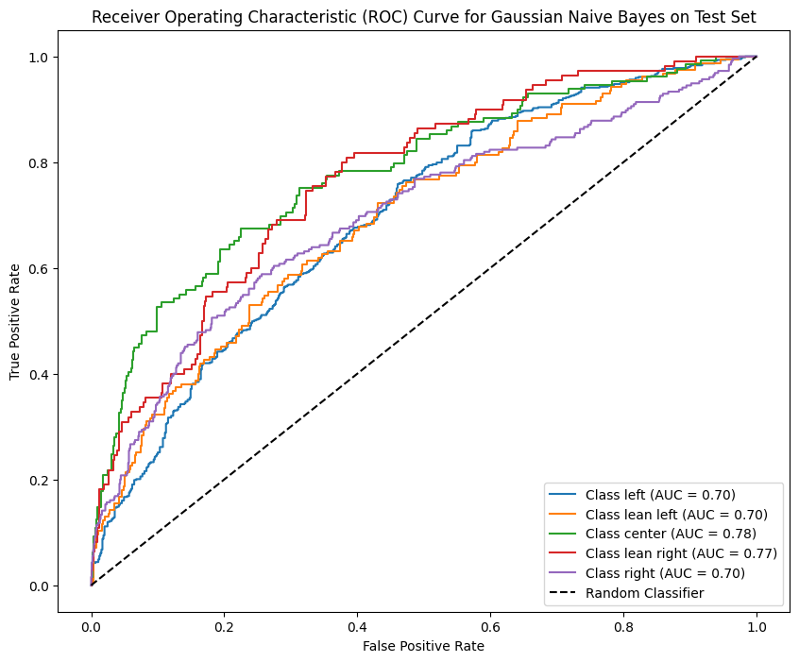
[1] Supervised: Gaussian NB
Sentence BERT (all-MiniLM-L6-v2) embeddings followed by PCA to recover 91% variance.
GNB assumes conditionally independent features which isn't suitable for our data
Accuracy: 0.4316
Precision (weighted): 0.5042
Recall (weighted): 0.4038
F1-Score (weighted): 0.4486

Slide 12
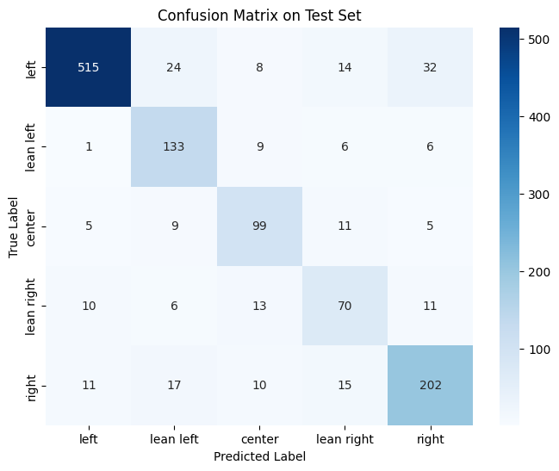
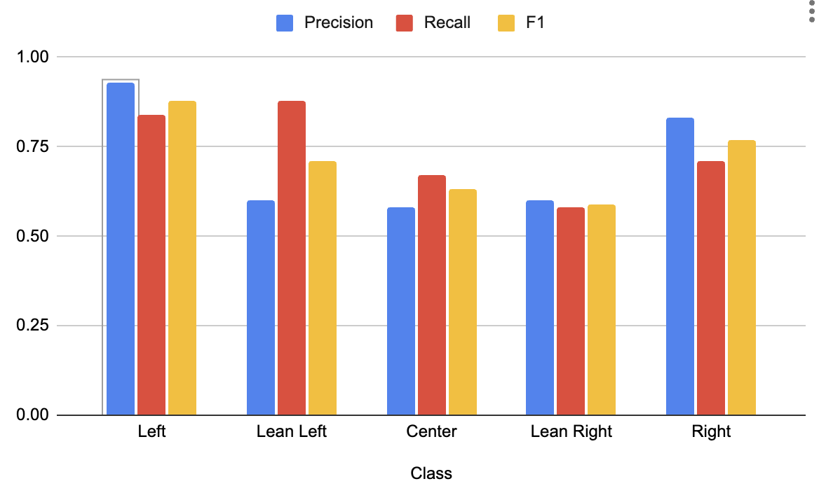
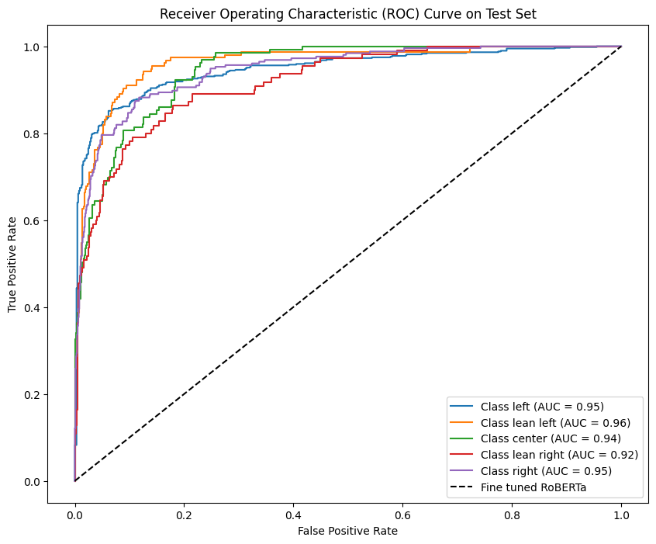
[2] Supervised: Fine-Tuned RoBERTa
Unlike GNB, RoBERTa learns context-sensitive representations and semantic nuances
Results:
Accuracy: 0.8205
Precision (weighted): 0.8309
Recall (weighted): 0.8205
F1-Score (weighted): 0.8237

Slide 13
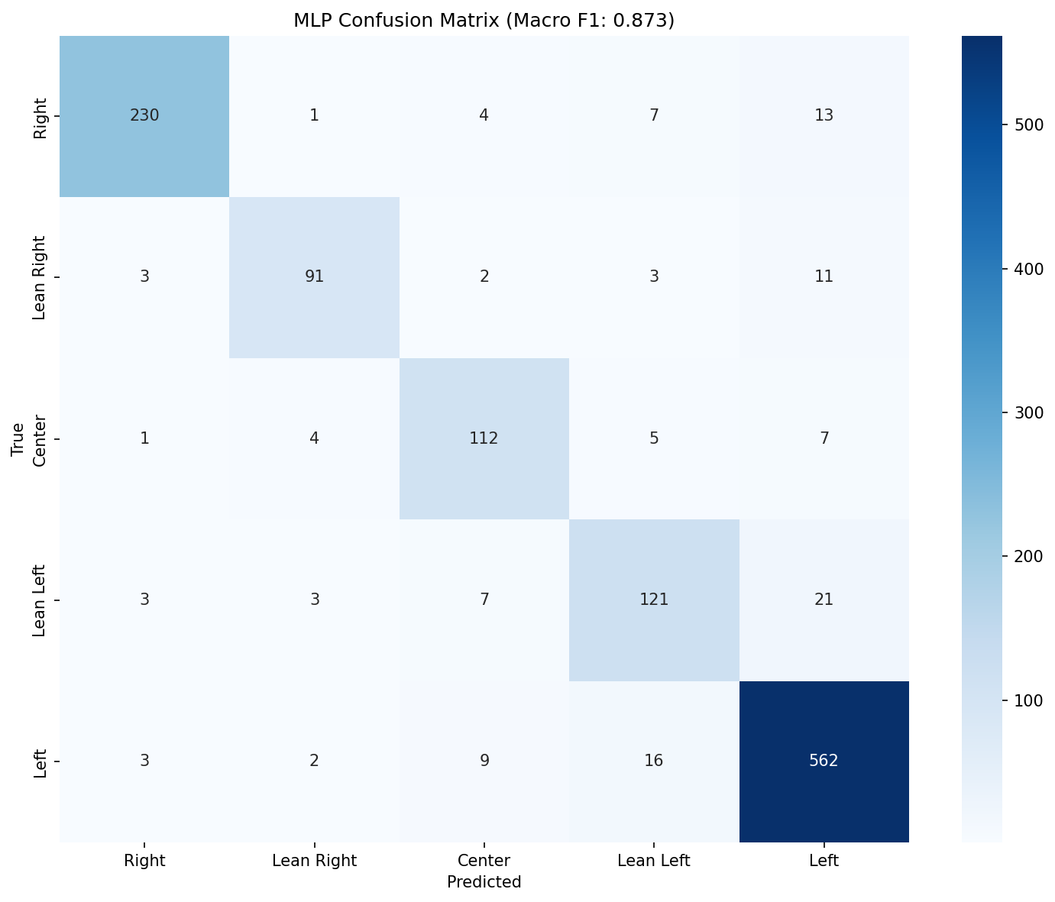
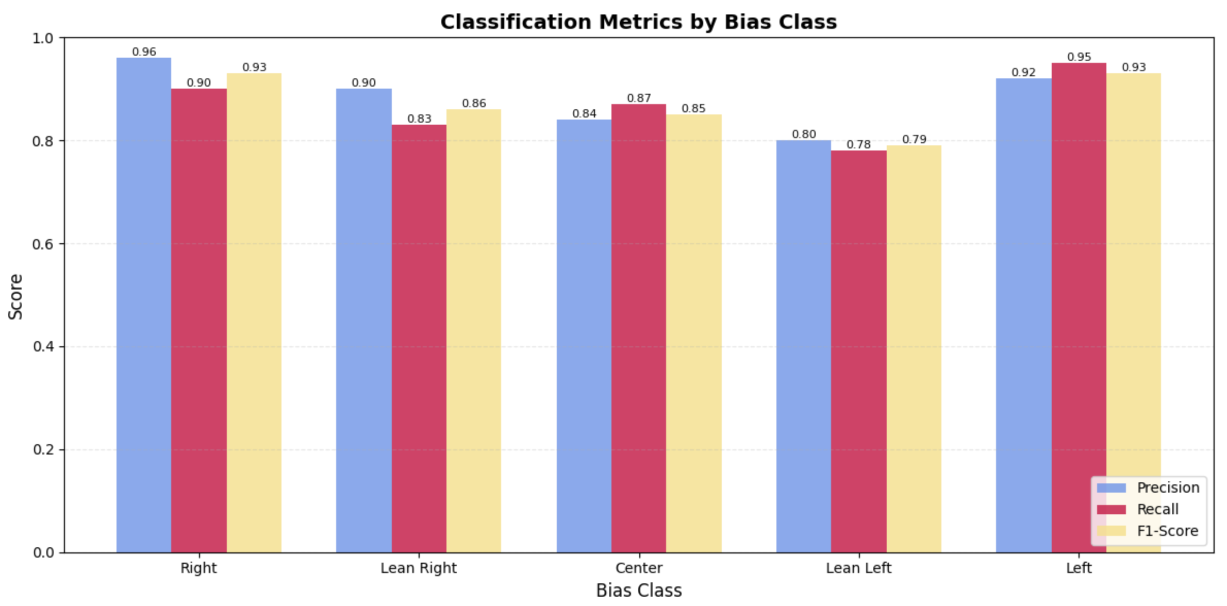
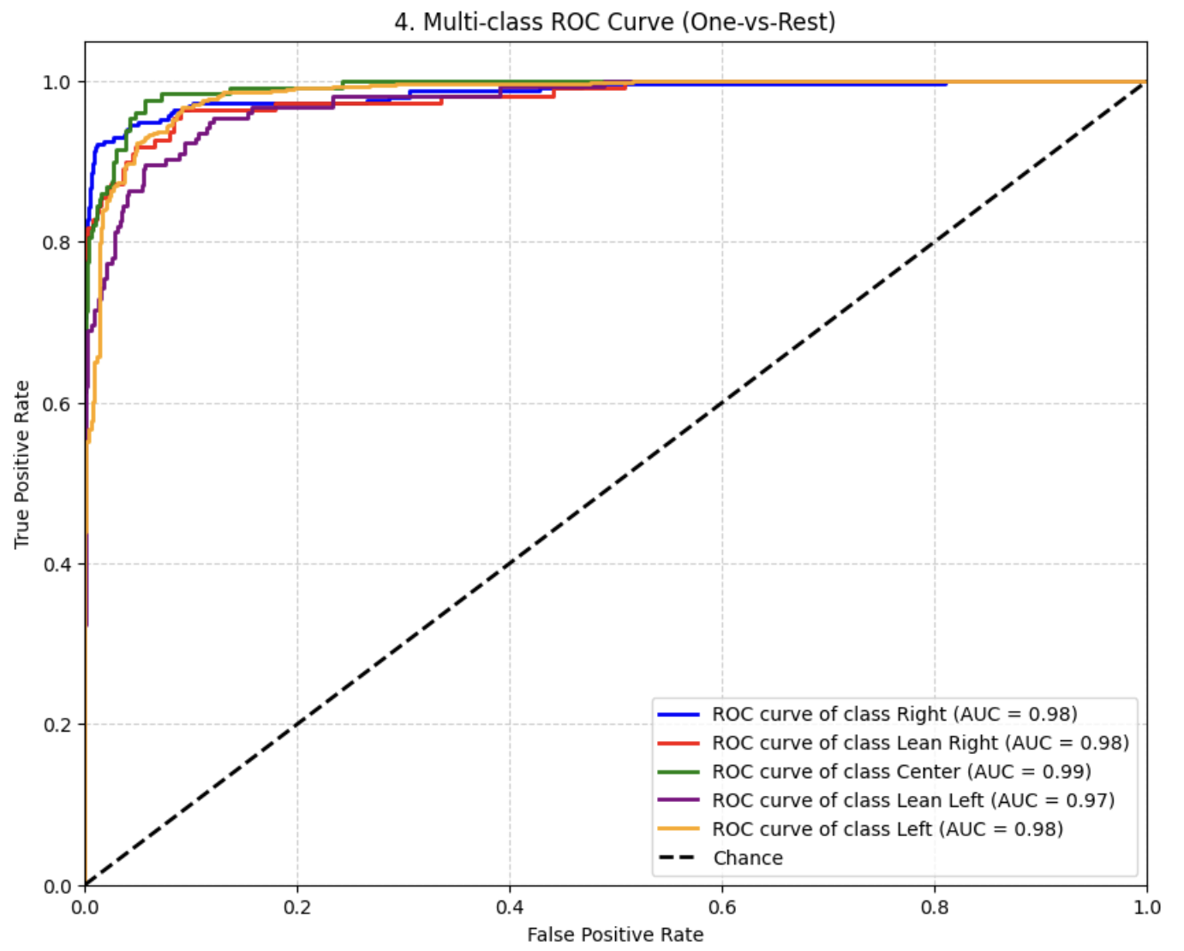
[3] Supervised: Multi-Layer Perceptron (MLP) with TF-IDF
Term Frequency-Inverse Document Frequency (TF-IDF) used for feature extraction
Assigns weights to words based on their frequency in a document relative to their frequency across the entire corpus
Results:
Accuracy: 0.8993
Macro F1: 0.8728
Weighted F1: 0.899
​
Strongest performance in the extreme categories

Slide 14
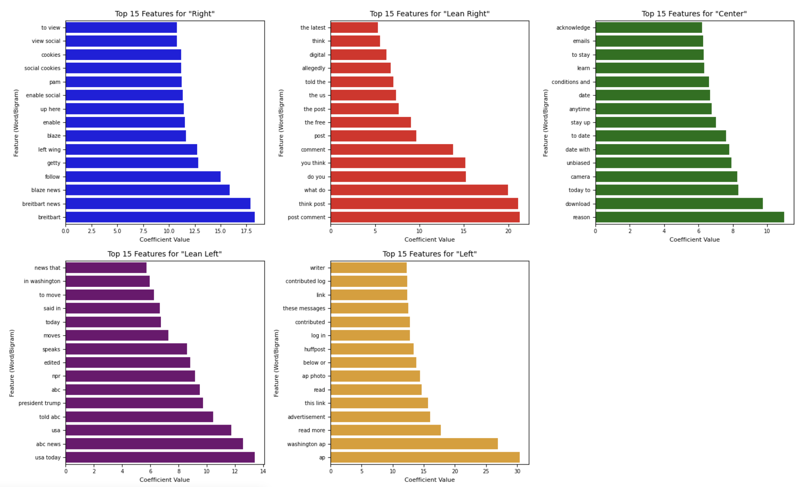
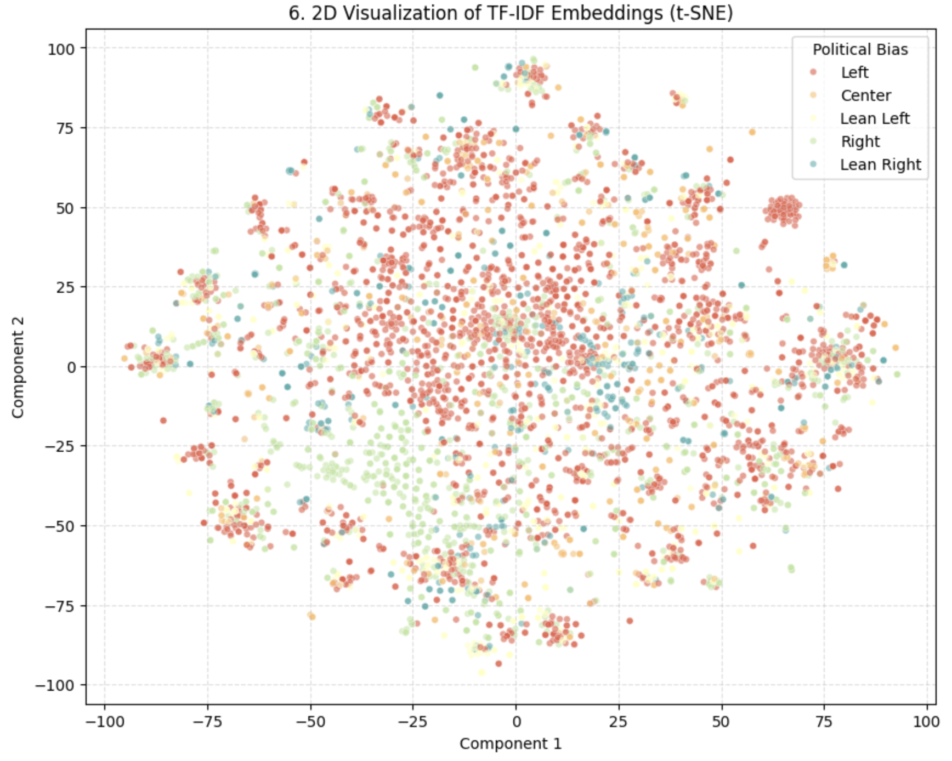
[3] Supervised: TF-IDF Visualizations

Slide 15
Supervised Results & Discussion
[1] Gaussian NB
[2] Fine-tuned RoBERTa
[3] MLP with TF-IDF
F1-Score (weighted): 0.4486
Assume features follow a Gaussian distribution, which is usually a poor fit for sparce data
Too simplistic for nuanced text classification as we're assuming conditional independence between features
F1-Score (weighted): 0.8237​
Self-attention mechanism
Pre-trained on massive amounts of text, allowing it generate contextualized embeddings
May not perform well on too small of a fine-tuning dataset
F1-Score (weighted): 0.899
TF-IDF features successfully capture term importance and differences in vocabulary of each bias group
MLP can learn complex, non-linear relationships

Slide 16
Insights
Model complexity vs performance:
GNB is simple and interpretable but lacks capacity for nuanced textual semantics
RoBERTa learns contextual representations, improving minority class performance over GNB but still limited by subtle ideological overlaps and our small dataset
TF-IDF + MLP leverages high-dimensional lexical features to achieve better overall performance, suggesting that surface-level patterns carry strong predictive signal in this dataset
Class-specific performance:
Minority or semantically similar classes (‘center’, ‘lean right’, ‘lean left’) remain difficult to classify
Confusion matrices show that RoBERTa reduces extreme misclassification but TF-IDF + MLP captures majority patterns effectively, hence its higher overall metrics

Slide 17
Appendix

Slide 18
Novelty
Methods we used:
SimCSE
Uses "Dropout as Data Augmentation" to create positive pairs from the same sentence without external labels.
Optimizes for Alignment (closeness of self-pairs) and Uniformity (spread of all embeddings) to learn semantic structure from scratch.
SetFit
"Data Amplification" technique that converts N labeled samples into N^2 contrastive pairs, maximizing learning efficiency from small datasets.
Decouples feature learning (Stage 1: Contrastive Loss) from prediction (Stage 2: Frozen Classification Head), preventing "catastrophic forgetting."

Slide 19
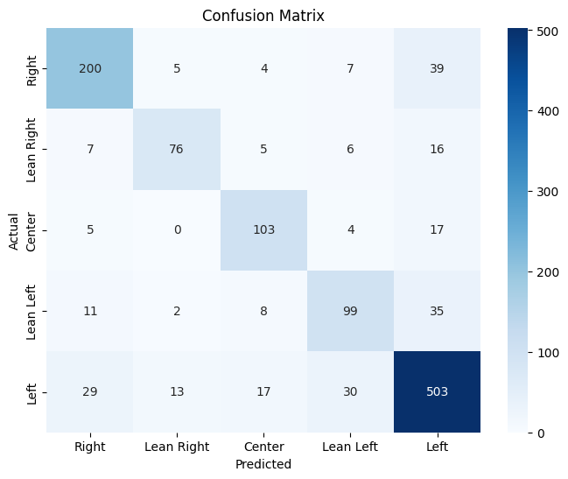
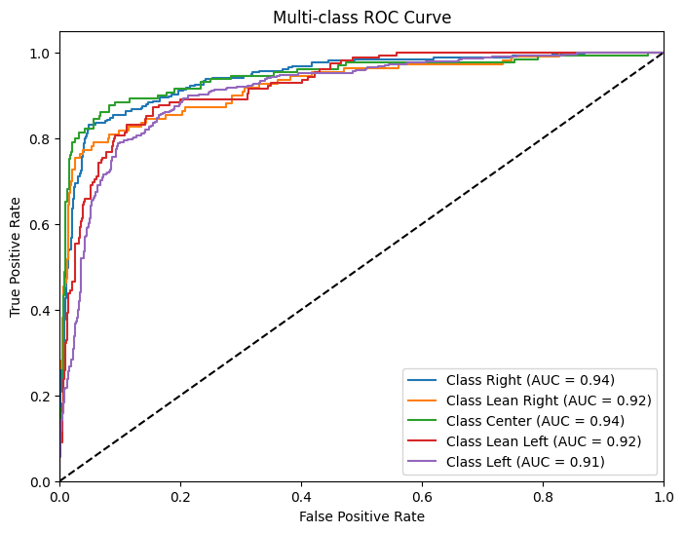
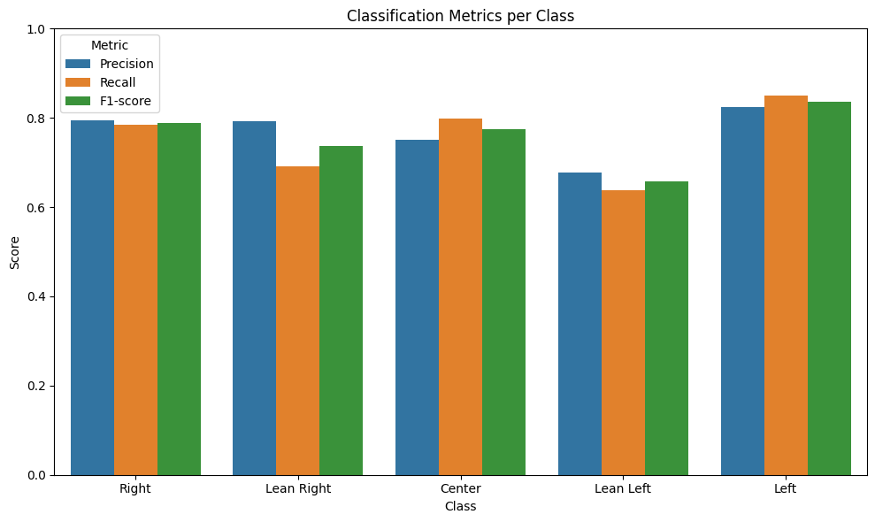
[1] SimCSE + Logistic Regression
Scraped unlabeled political text from huge textual datasets to leverage massive amounts of (potentially poor) data
Trained the base model of roberta-base using contrastive learning to learn political nuances and performed logistic regression on these embeddings
Results:
Accuracy: 0.7905
Macro F1: 0.76
Weighted F1: 0.79

Slide 20
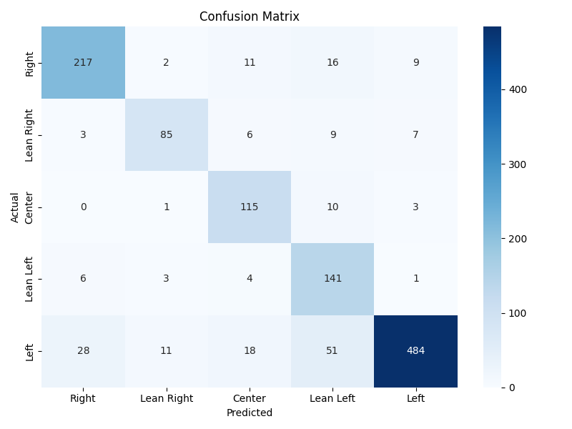
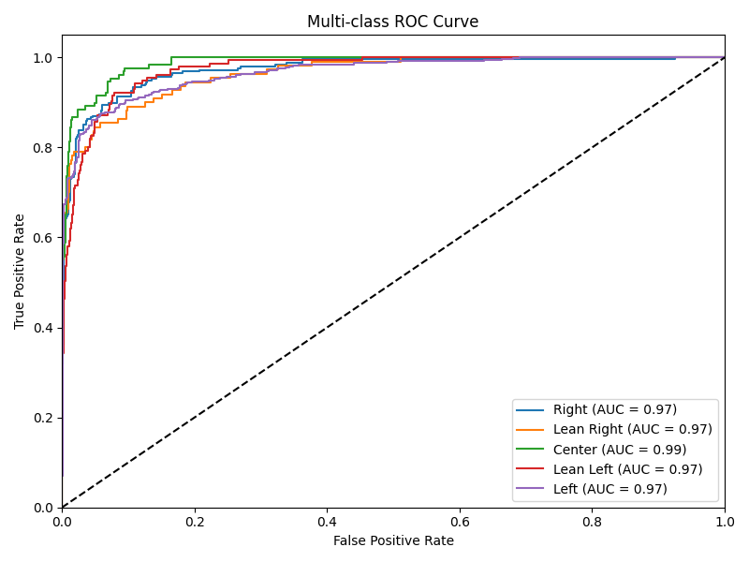
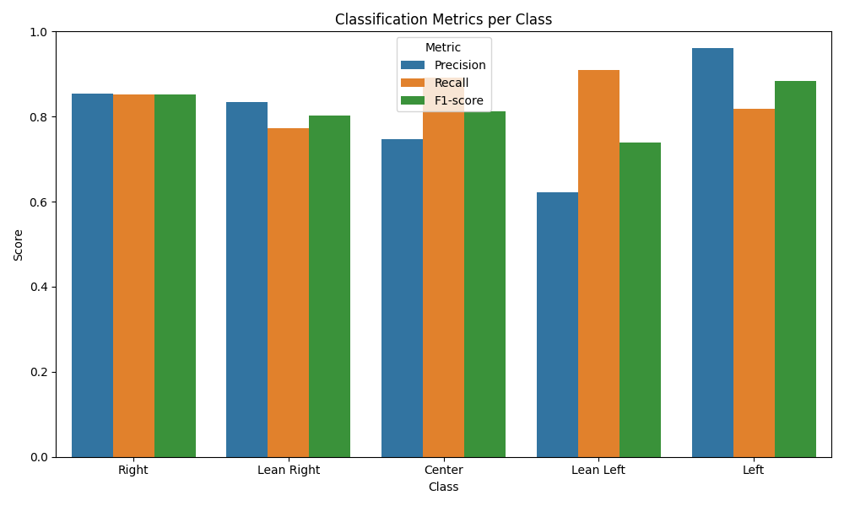
[1] SimCSE + Finetuning
Trained the base model of roberta-base using contrastive learning to learn political nuances and performed logistic regression on these embeddings
Later finetuned the classification head of roberta
Results:
Accuracy: 0.839
Macro F1: 0.82
Weighted F1: 0.84

Slide 21

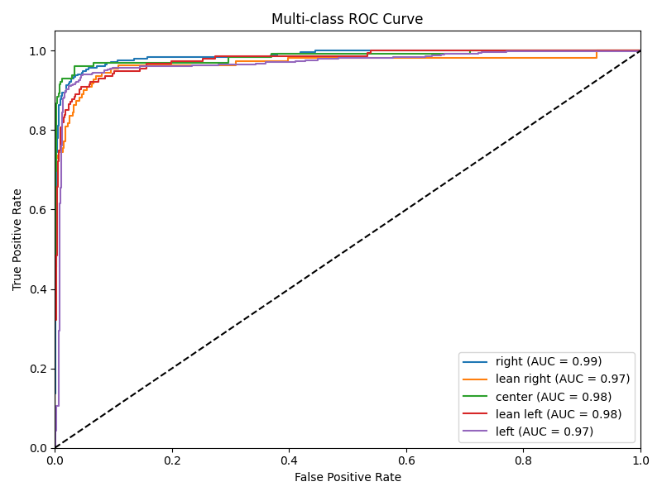
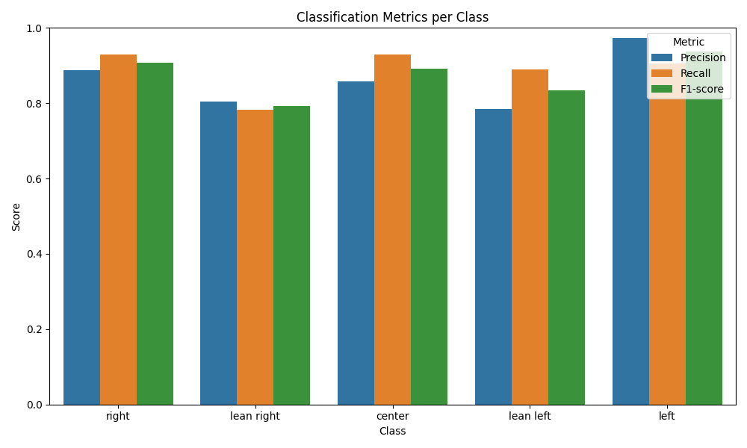
[2] SetFit
Dataset amplification: Convert N sample inputs for a label class to N^2 input pairs
Fine-tuned the sentence transformer using Supervised Contrastive Learning, forcing the model to cluster text physically by political stance rather than just topic
Results:
Accuracy: 0.900
Macro F1: 0.8729
Weighted F1: 0.9011

Slide 22
References
[1] R. M. Entman, “Framing: Toward Clarification of a Fractured Paradigm,” Journal of Communication, vol. 43, no. 4, pp. 51–58, 1993.
[2] R. Baly, G. Karadzhov, D. Alexandrov, J. Glass, and P. Nakov, “Predicting Factuality of Reporting and Bias of News Media Sources,” in Proc. ACL, 2018.
[3] N. Reimers and I. Gurevych, “Sentence-BERT: Sentence Embeddings using Siamese BERT-Networks,” in Proc. EMNLP-IJCNLP, 2019.
[4] P. Khosla et al., “Supervised Contrastive Learning,” in Proc. NeurIPS, 2020.
[5] J. Jiang, X. Ren, and E. Ferrara, “Retweet-BERT: Political Leaning Detection Using Language Features and Information Diffusion on Social Networks,” Proc. AAAI ICWSM, vol. 17, pp. 459–469, Jun. 2023. doi: 10.1609/icwsm.v17i1.22160.
[6] A. Pastorino et al., “Decoding News Narratives: A Critical Analysis of Large Language Models in Framing Detection,” 2024.
[7] Y. Wang, S. Frederick, Y. Duan et al., “Detecting Misinformation through Framing Theory: the Frame Element-based Model,” 2024.
[8] J. Rönnback, J. Carlsson, C. Calleja, and R. Feldman, “Automatic large-scale political bias detection of news outlets,” PLOS ONE, vol. 19, no. 8, e0321418, Aug. 2024. doi: 10.1371/journal.pone.0321418.
[9] L. Fan, M. White, E. Sharma, R. Su, P. K. Choubey, R. Huang, and L. Wang, “In plain sight: Media bias through the lens of factual reporting,” EMNLP, 2019. doi: 10.48550/arXiv.1909.02670
[10] S. Haldar, “AllSides : Ratings of bias in electronic media,” Kaggle.com, 2021. https://www.kaggle.com/datasets/supratimhaldar/allsides-ratings-of-bias-in-electronic-media/data
[11] The GDELT Project, “The GDELT Project,” Kaggle.com, 2015. https://www.kaggle.com/datasets/gdelt/gdelt
[12] idiap, “GitHub - idiap/Factual-Reporting-and-Political-Bias-Web-Interactions: Mapping the Media Landscape: Predicting Factual Reporting and Political Bias,” GitHub, 2024. https://github.com/idiap/Factual-Reporting-and-Political-Bias-Web-Interactions

